Slide 1
Roadside Safety Training
Caltrans - Back 2Work Training Crews
Notes:
Introduce yourself, Name/title, credentials to be the administer of the training
*Disclaimer: Butte County Office of Education' Quarterly safety trainings are informational and should not Supersede Employers Standard Operational Procedures. It is the Employers responsibility to ensure a Safe and Healthful work place and all liability is on the Employing agency.*

Slide 2
Back 2 Work History
Purpose of initial 8 Work Crews in Sacramento 2008
Create Opportunities into the Workforce
Lower Recidivism Rate
Solve California’s Litter Problem
Butte County office of Education – Back 2 Work Department 2013
Services underemployed/unemployed disadvantaged populations such as Justice involved, U.S. Military Veterans and those experiencing Homelessness
119 Crews Operating under Back 2 Work in 41 Counties and growing….
Notes:
Discuss history from 2008 to now

Slide 3
Back 2 Work Family
Center of Employment Opportunities
Chrysalis
Community Services Employment Training
Conservation Corps of Long Beach
Elijah House
Farmworkers Institute of Education & Leadership; Cesar Chavez Environment Corps
Five Keys
Lincoln Training Center
Managed Career Solutions
Orange County Conservation Corps
San Bernardino Community College District
San Francisco Conservation Corps
Urban Corps of San Diego County
Notes:
Current Sub-contractors under BCOE for the Caltrans Litter abatement SPP Crews

Slide 4
B2W Mission
Offer transitional employment programs throughout California to help men and women overcome employment barriers. By building strong community relationships our programs provide the necessary resources for clients to successfully enter today’s workforce.
North Star
Change systemic inequalities to unleash workforce opportunities for all!
Notes:
Have someone read the Mission or you can. Make sure to emphasize Transitional Employment, Overcoming barriers, successful employment attainment
Easier to get a job when having a job, start now for a better tomorrow(success), cant wait to the end to start working on transition it needs to start now!

Slide 5
Todays Objectives
Discuss Scope of Work and Responsibilities
Selection of Proper Clothing and Personal Protective Equipment
Recognize potential Hazards and suitable abatement measures
Identify Proper use and Placement of signs
Proper Retrieval of litter/debris
Appropriate Handling of Hypodermic Needles
Heat Illness Prevention
Increase Knowledge to maintain Safety First approach
Notes:
Todays agenda read
*Disclaimer: Butte County Office of Education' Quarterly safety trainings are informational and should not Supersede Employers Standard Operational Procedures. It is the Employers responsibility to ensure a Safe and Healthful work place and all liability is on the Employing agency.*

Slide 6
Scope of Work
Work:
Litter and Debris removal
No litter/Debris present duties can include but not limited to:
Weed/ Vegetation Control, Trim/remove brush/trees, Make firebreaks, Remove Fire Tinder, plant/seed natural vegetation, plant restoration in landscape, general clean up and yard work at CT stations (NOT including Janitorial work), & minor Storm damage repair
Tools used:
Hand Picker, Shovels, Rakes, Hoes, Pitch Forks, Push Brooms, Pruners, Weed eaters.
No Complex Equipment
Notes:
Discuss work, not limited to, Tools to be used, no complex equipment ie… chain saws, weed eaters with blades attached, Power shears, chippers so forth…
Clean CA Main Litter- minimum 900 litter bags a month per crew Only Litter and Debris remove count for Clean CA measurables

Slide 7
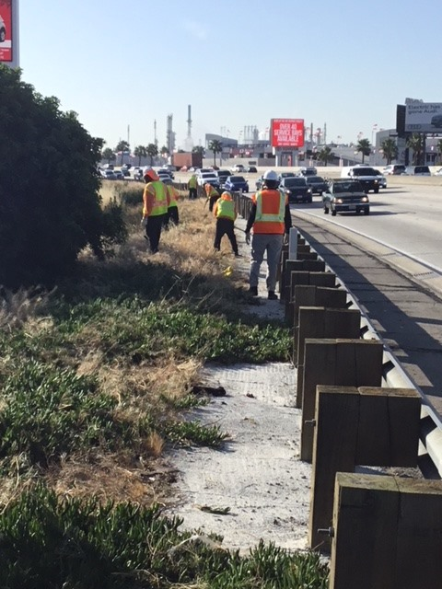
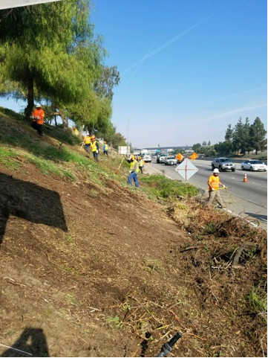
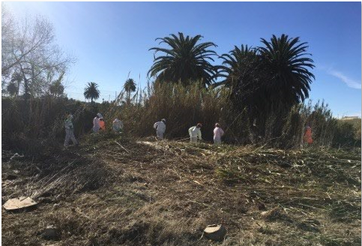
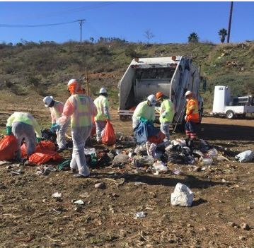
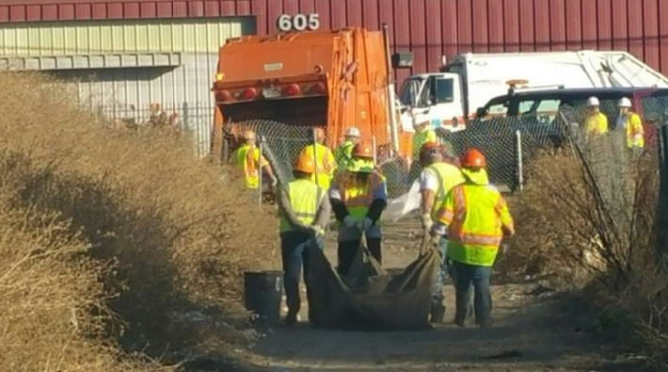
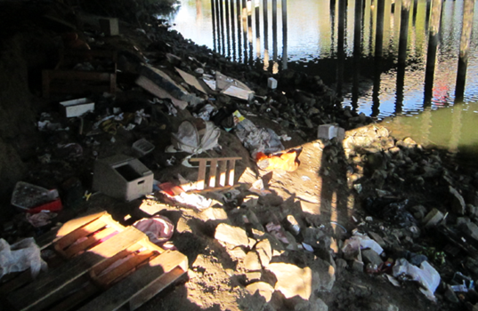
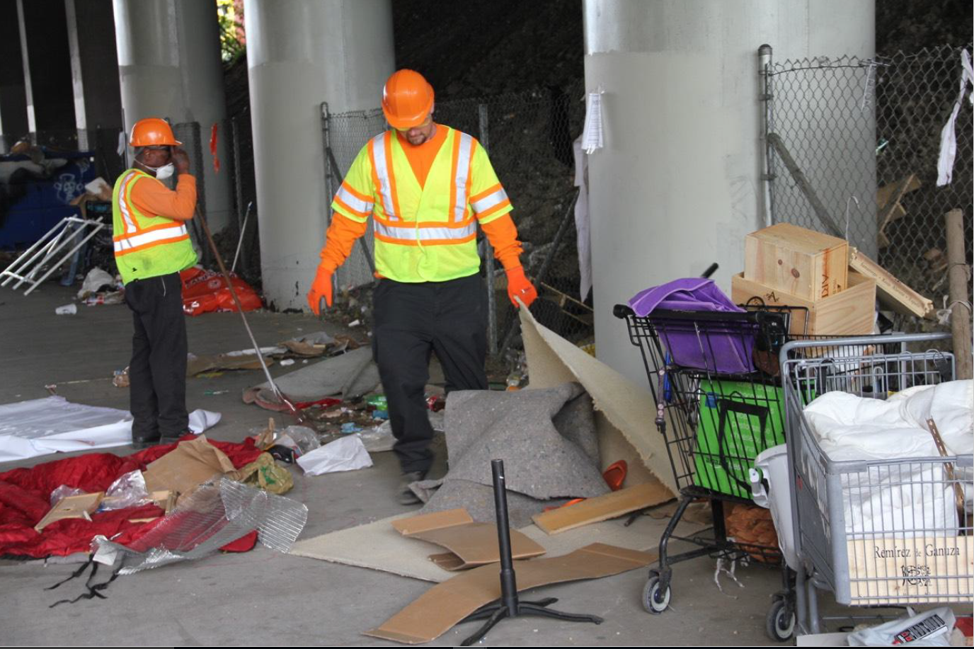
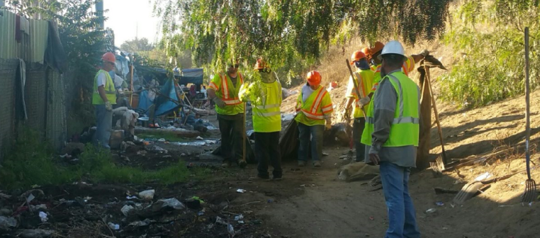
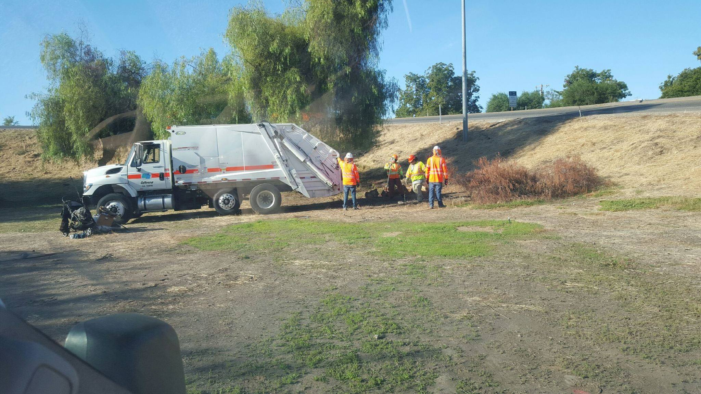
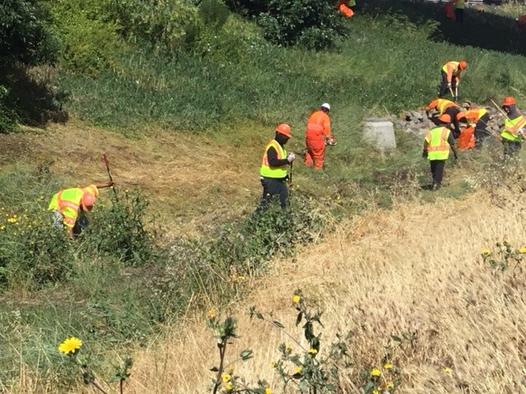
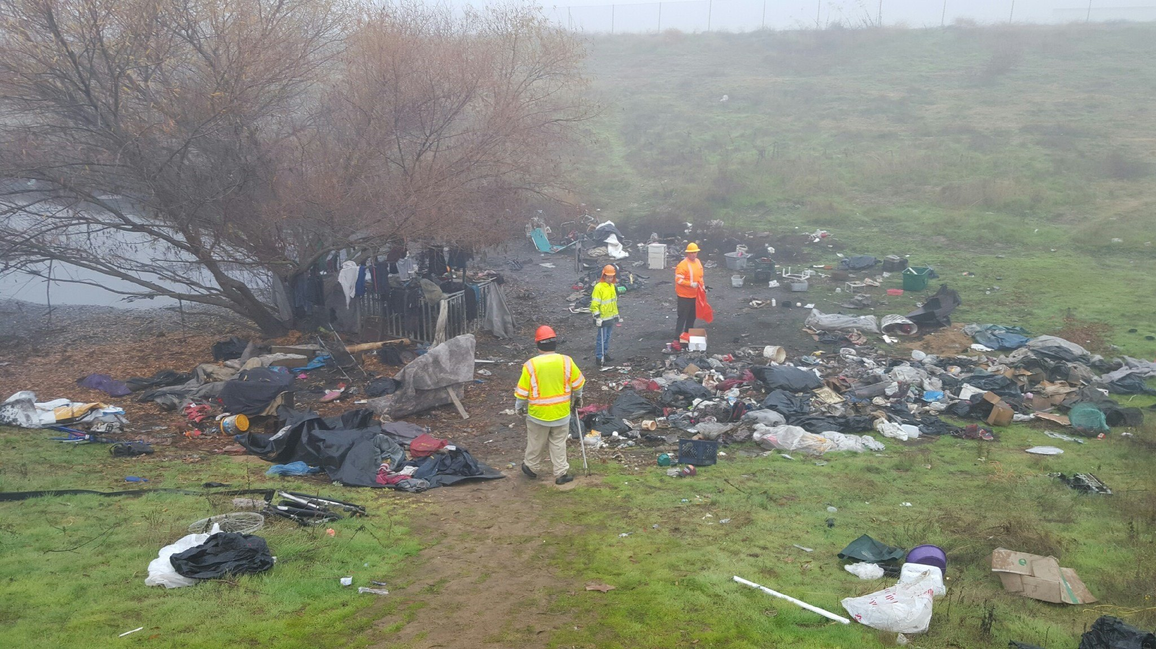
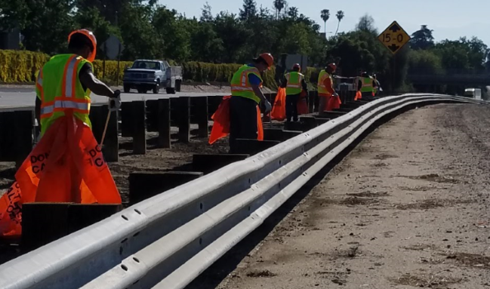
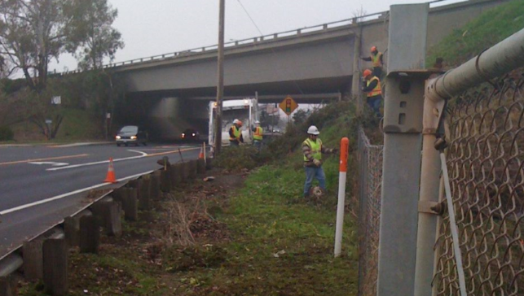
Notes:
Pictures of B2W work crews in action!

Slide 8
Crew Leaders Responsibilities
Understand, implement, maintain and enforce safety rules
If the plan is not safe communicate with Caltrans, Regroup to a Safe Zone and Re-plan the safest strategy for work order
Plan the work to ensure each employee has adequate space
Ensure employees understand how to work safely
Pre-operational safety briefings, Tailgates, PPE’s, Chapter 8, and CSOP’s
Provide necessary equipment to complete assigned tasks safely
Pre and Post inspections of Vehicle, Trailer and Equipment
Trained in First Aid and Maintain all First Aid Kits
Conduct post-job discussion
Notes:
Gotta know the rules to enforce them.
“Understand” is the key word; when working within the highway environment, this is imperative.
Leaders should not only know the rules, they need to enforce them.
All workers shall have the proper gear. If they don’t, they can’t work.

Slide 9
Crew Members Responsibilities
Follow all safety rules/policies
Report all injuries/illnesses, hazardous conditions to supervisor
Be free from the effects of medication, controlled substances, alcohol, or illnesses
Notify supervisors of any personal Medical condition or prescribed medication use that might impair ability to perform duties
Report to supervisor any behavior by co-worker that indicates that they are not fit for duty
Do everything reasonably necessary to protect your own safety and that of your co-workers
Be the best You!
Notes:
Self-explanatory. We all have to follow the rules.
Reporting injuries is a given; if you’ve injured yourself while working, let your supervisor know BEFORE the shift ends.
If exposure to something on the job as made you sick, let your supervisor know that as well.
Certain medications have side effects; notify your supervisor!
If you’re too sick to work, you shouldn’t be out on the highway.
There’s that “protect your co-workers” thing again…
Employees shall do everything reasonably necessary to protect their own safety and health and
that of others by complying with all safety and health policies, procedures, laws, rules, or
regulations. Employees shall report all injuries, illnesses, or hazardous conditions to their
supervisor immediately, or at least by the end of the work shift.
Employees are expected to report to work mentally and physically capable of performing all of
their assigned duties without jeopardizing the safety and health of themselves, other employees,
or the public. Employees shall be free from the effects of medication, controlled substances,
alcohol, or the complications arising from illness or injury, which might impair their judgment
and/or ability to perform their work.
Employees are responsible to notify their supervisor of any personal medical condition or
prescribed medication use that might impair their ability to perform their assigned duties.
Employees should also report to their supervisor any behavior by another employee that
reasonably indicates that they are not fit for duty.
Any employee who violates any safety and health policy, procedure, regulation, law, or rule will
be disciplined in accordance with Departmental Policy.

Slide 10
Safety on the Job is #1
Safety is the most important part of the job!
How do we do this?
To be safe we need to:
Let motorists know what’s going on
Signs, Barricades, Cones, Amber Lights, ext..
Avoid the errant driver
Face Traffic, Stay Aware through eyes & ears, Lookouts, Planning Escape Routes
Using Protective equipment
Protective Vehicles(Early Warning, Barrier, or Shadow), Use of Seat Belts, PPE’s
Plan the work to reduce exposure to traffic
Knowledge is Key
Notes:
Letting the motorists know what is going on and where to drive.
For this we use signs, barricades, cones, flashing amber lights, portable changeable
message signs (PCMS) and flashing arrow signs (FAS), and other traffic control
devices.
(B) Avoiding the errant driver.
Face traffic, stay aware through your own eyes and ears or those of a lookout who will
warn you. Plan your escape route.
(C) Using protective equipment.
Protective vehicles, headrests, seat belts/shoulder harnesses, and personal protective
equipment as described in the Caltrans Safety Manual, Chapter 12.
(D) Planning the work to reduce employee exposure to traffic.
Your personal safety comes first. Think safety in everything you do, especially while out on the highway.
We owe it to the public to let them know we’re out there working. That’s why we place warning signs.
Avoid the errant driver by being watchful and alert.
We’ll talk more about barriers in a bit.
Don’t just blindly stop along the road and dump everyone out; make sure you have reviewed the area and can keep your workers safe during the project.
Plan for safety contingencies; know what to do if something happens.

Slide 11
Caltrans Safety Guidelines
CSOPs are written guidelines that identify hazards specific to particular tasks and explains how to safely accomplish the work.
Read, Discuss, and document CSOP with employees prior to performing work daily
Chapter 8: Protection of Workers:
It is designed to help employees in their efforts to work safely. All employees are expected to follow these minimum guidelines
http://www.dot.ca.gov/hq/maint/manual/maintman.htm
Notes:
Go over the CSOPs and Chapter 8, If time permits Show SPP CSOP and Lookout CSOP

Slide 12
Safety Preparation
Caltrans Maintenance Equipment Training Academy (META) SPP Training
Daily Tailgates to include:
CSOP’s, Ch. 8, and best advise aligned with work order
Specific hazards to work locations
Seasonal Safety Hazards
95 degrees or above Heat Illness Prevention (Cal-OSHA)
Quarterly Safety Trainings
All to be Document on PM-S-0110 or Equivalent
Notes:
5 Ps= Prior Preparation Prevents Poor Performance
PPP=PPP

Slide 13
Proper Work Clothing
Long pants
preferably denim jeans, or equivalent
Pants must be worn around the waist (Sagging pants create hazards)
Long or short-sleeved shirts
No bare shoulders
Sleeve length can be determined by employer
Footwear
Sturdy work shoe or boot with puncture-resistant uppers and a non-slip sole
Notes:
Long pants will protect your legs from stickers/brambles/snakes/etc.
We don’t want you to get sunburned while on the job.
A work boot will not only give you ankle support on uneven ground, the sturdy soles may protect against nail punctures or cuts from broken glass.

Slide 14
Required Personal Protective Equipment Provided by Employer; No Caltrans Logo’s
Orange Color Safety Hardhat (ANSI Class G)
Safety Glasses ANSI Z87.1
Puncture resistant gloves
Lime green safety vests ANSI Class II or Class III
Raingear if needed, must be ANSI Class III compliant other warning garments must be worn over the raingear.
Notes:
Puncture Resistant Gloves will protect you from contaminated objects from puncturing and infecting, blisters, etc.
Safety glasses will protect your eyes from flying material; you only have two.
The hard hat is a part of the uniform and will protect your head.
Warning vest will make you visible
Make sure to talk about properly using/wearing PPES I.E… vest closed, PPEs on prior to getting out of work van. PPEs must be on at all times on work site, Warning vest minimum at CT yards

Slide 15
Warning
What industry are you working in?
Roadside Construction
According to National Institute for Occupational Safety and Health Between 2003-2015:
1,571 workers lost their lives at road construction sites.
Fatal work-related injuries at road construction sites averaged 121 per year.
Texas ranked as the state with the most worker deaths at road construction sites (171), followed by Florida (104), Pennsylvania (85), Illinois (69), California (69), and Tennessee (62).
Notes:
Your personal safety comes first. Think safety in everything you do, especially while out on the highway.
We owe it to the public to let them know we’re out there working. That’s why we place warning signs.
Avoid the errant driver by being watchful and alert.
We’ll talk more about barriers in a bit.
Don’t just blindly stop along the road and dump everyone out; make sure you have reviewed the area and can keep your workers safe during the project.
Plan for safety contingencies; know what to do if something happens.

Slide 17
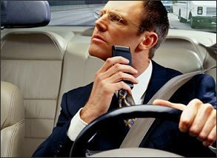
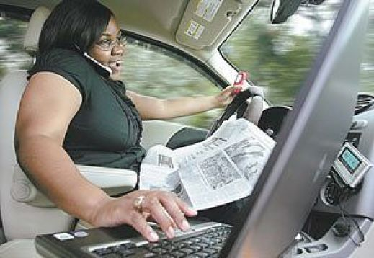
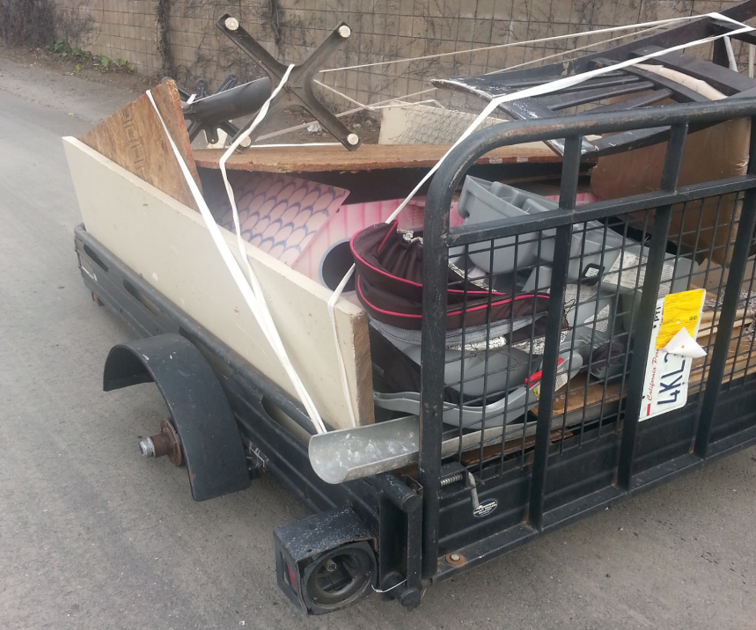
We have no control over what the motorist do…
But we do have control over what we can do to protect ourselves!
Notes:
We have no control over what the motorist does, but we do have control over what we can do to protect ourselves.

Slide 18
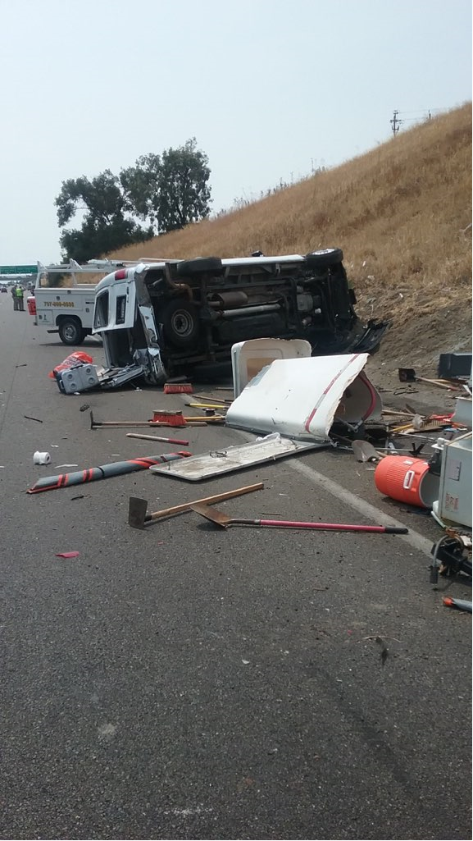
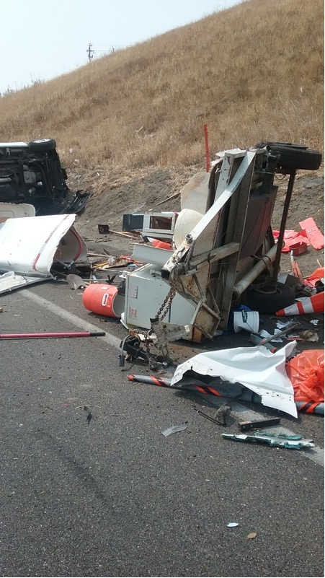
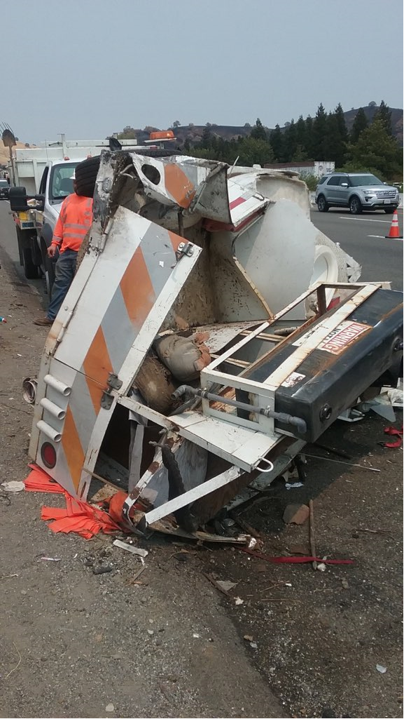
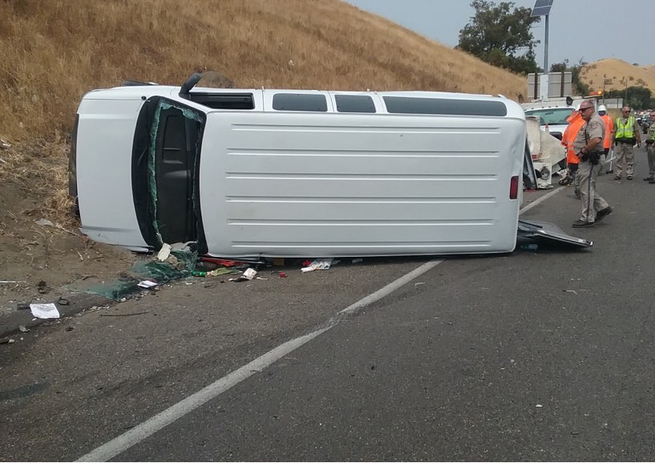
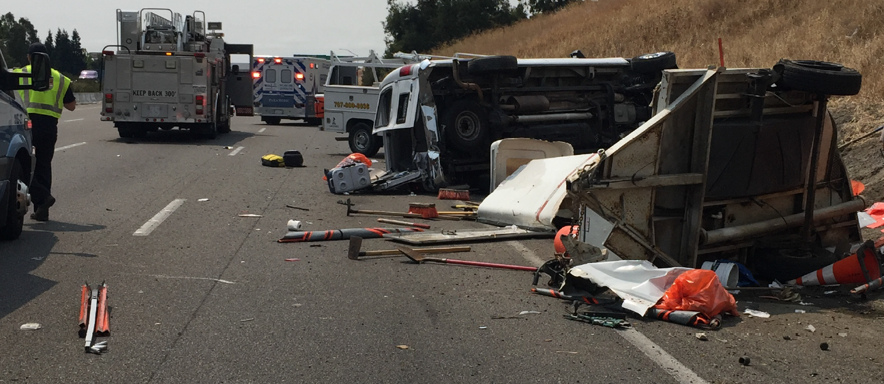
Notes:
Fairfield 2018- 4 lane highway, distracted driver went from lane 4 to lane 1 quick, clipped the back corner of trailer
Crew member was carrying Tire back to trailer – struck by incident- almost took her ankle off my random material in the trailer while flipping
Van followed trailer and flipped, Supervisor had to have windshield busted out to get out of the vehicle.
Errant vehicle spun around after clipping trailer and hit lookout
Warning horn from lookout was did not go off
Luckily everyone survived, Participant that was struck by material, had over 17 surgeries to keep her ankle, Lookout was bruised and in shock, Supervisor made it out with significant pain
Use this picture to talk about: Working next to van or trailer Big No, when bringing material back to the trailer have a team member look out for you from a safe zone, do not run but move with a purpose to get back to drop material in trailer and then move back to safe zone, Communicate with driver via hand signals/verbal when going towards trailer(get confirmation), using the porta-potty on live right away, rotating look outs, dangers of working on the highway.

Slide 19
Working Near Moving Traffic
If available, a vehicle, regardless of its size, shall be used as physical protection from traffic
Workers on foot shall face traffic whenever possible
Use eyes and ears to look and listen for hazards and errant vehicles
Have identify Escape routes, Avoid “bunching up”
If there are two or more persons doing the work close together, a lookout may (Will) be necessary
Notes:
Out of control vehicles can kill and maim. It’s potentially the most dangerous thing you’ll ever encounter while working out on the road.
Here’s the “use your vehicle as a barrier” thing again.
Face traffic, face traffic, face traffic. The three most important things you can do to avoid being hit!
Assign someone the task of being a lookout; make it a reward for a good attitude; it’s an IMPORTANT job!
Maintenance forces shall plan escape routes when they arrive at the work zone and any time the job location changes within the work zone.
Consider the following when planning and establishing an escape route:
• A path you can use to get out of the way of errant vehicles
• The use of vehicles, equipment, terrain, vegetation and structures to shield you from errant vehicles
• All of the possible directions that vehicles can enter the work zone
• Worksite and activity hazards such as trenches and drop-offs within or near the work zone
Supervisors shall plan work so that each employee has adequate space to work safely.
Supervisors shall ensure that employees know their responsibilities for positioning themselves so that each employee has enough work space to work safely and avoid being struck by flying material or another Maintenance force’s tools.
Maintenance forces shall avoid "bunching up", which increases traffic exposure and causes public concern.

Slide 20
Protective Vehicles
Shadow
Provide physical protection & have many safety requirements
Barrier
A barrier vehicle is an unoccupied vehicle or piece of equipment used to protect Maintenance forces from errant motorists.
Any vehicle at a work site can be used as a barrier. However, Maintenance forces shall use the heaviest vehicle reasonably available.
Advanced Warning
An advance warning vehicle is driven or placed upstream from a work zone
If the vehicle encroaches into the traveled way, it shall be equipped as a shadow vehicle.
Our Vans are Advanced Warning Vehicles
Notes:
Refer to Ch. 8.11.01 Shadow Vehicle:
A shadow vehicle shall be used to protect the work vehicle in a moving lane closure or when setting or retrieving lane closures. A shadow vehicle shall:
(a) Have a truck mounted attenuator (TMA) which softens the blow to our driver, and usually reduces the impact to the motorist. It may not reduce the distance a vehicle will roll ahead when hit.
(b) Be equipped with Type II FAS or PCMS.
(c) Be equipped with head restraint or high back seats.
(d) Be equipped with seat belts that have lap and shoulder harnesses.
(e) Be equipped with a two-way radio.
Typically, the shadow vehicle is occupied by the driver only.
Refer to Ch. 8.11.02 Barrier Vehicle:
A barrier vehicle is an unoccupied vehicle or piece of equipment used to protect Maintenance forces from errant motorists. Any vehicle at a work site can be used as a barrier. However, Maintenance forces shall use the heaviest vehicle reasonably available. In certain instances, more than one (1) barrier vehicle may be needed. A barrier vehicle does not require a TMA. However, if a TMA is available, it should be used.
Any vehicle that is used should be parked upstream from the work site between approaching traffic and the Maintenance forces. It should be parked where it will provide the best protection; not too close to the Maintenance forces, not too far back. It shall be carefully positioned so that it will intercept errant vehicles, but will not roll ahead into the work area. Always park the barrier vehicle with the emergency brake set and lower any attachments to the ground.
A barrier vehicle without a TMA can be parked a number of ways. It can be parked at an angle or straight across the lane in a closure. If it is parked at an angle, the front of the vehicle should be pointed away from traffic. The wheels shall be turned away from the work zone and away from traffic if possible. This will avoid motorist panic and prevent secondary collisions if the barrier vehicle is hit and pushed ahead. A barrier vehicle with a TMA should normally be parked parallel with the direction of traffic.
Refer to Ch. 8.11.03 Advanced Warning Vehicle
An advance warning vehicle is driven or placed upstream from a work zone (refer to the Moving Lane Closure Plans T15, T16 or T17). It alerts the approaching motorists of work being performed on or near the travel way.
If the vehicle encroaches into the traveled way, it shall be equipped as a shadow vehicle and operated in accordance with the guidelines in Section 8.11.01. If it encroaches into a freeway lane, the vehicle shall display a FAS or PCMS in the arrow mode. If it encroaches into a two-way conventional highway, the FAS or PCMS shall be in the caution mode, or display a flashing or rotating amber light.

Slide 21
Protection from Moving Traffic
Your vehicle can protect the crew while working on the shoulder; any available vehicle can be used
Place the vehicle between traffic and workers on foot
Set the parking brake when parked
Do not work directly behind Trailer
Use/be aware of any natural or man-made barriers that are available as protection from traffic.. Trees/Guardrails…..
Notes:
According to statistics, vehicles involved in run-off-the-road accidents leave the highway at a 15-45 degree angle. At that angle, a car’s tires don’t squeal or make a sound. If you’re not watching, you’ll never see it coming.
That’s why it’s important to use the vehicle as a barrier to traffic.
When parked, keep the parking brake set and turn the wheels away from workers on foot. If it gets hit, you don’t want it running over your people.
If gathering in a group to talk/give instructions/ etc. Be mindful of where you’re gathering.

Slide 22
Lookouts
A lookout shall be assigned if all of these conditions exist:
Posted speed limit of 55 mph or more
Workers are without physical protection
2 or more people working close to each other
Working within 30 feet of moving traffic
A person is on foot
A lookout shall not be assigned any other duties
Lookouts should continually watch traffic to warn workers about errant vehicles
Rotated out regularly to prevent “complacency”
Notes:
Refer to CSOPs Appendix P Lookout Guidelines
Conditions requiring a lookout. A lookout shall not be assigned any other duties and shall be rotated often enough to keep them alert.
The lookout shall continuously watch approaching traffic for errant vehicles that may hit Maintenance forces on foot. If trouble is suspected, the lookout shall warn the Maintenance forces by yelling, using a vehicle or warning horn, a portable lookout alarm device, or any system capable of communicating the warning message. This warning is intended to give Maintenance forces the time to use a planned escape route to avoid the errant vehicle.
A lookout shall not be assigned any other duties and rotated often enough to keep them alert.

Slide 23
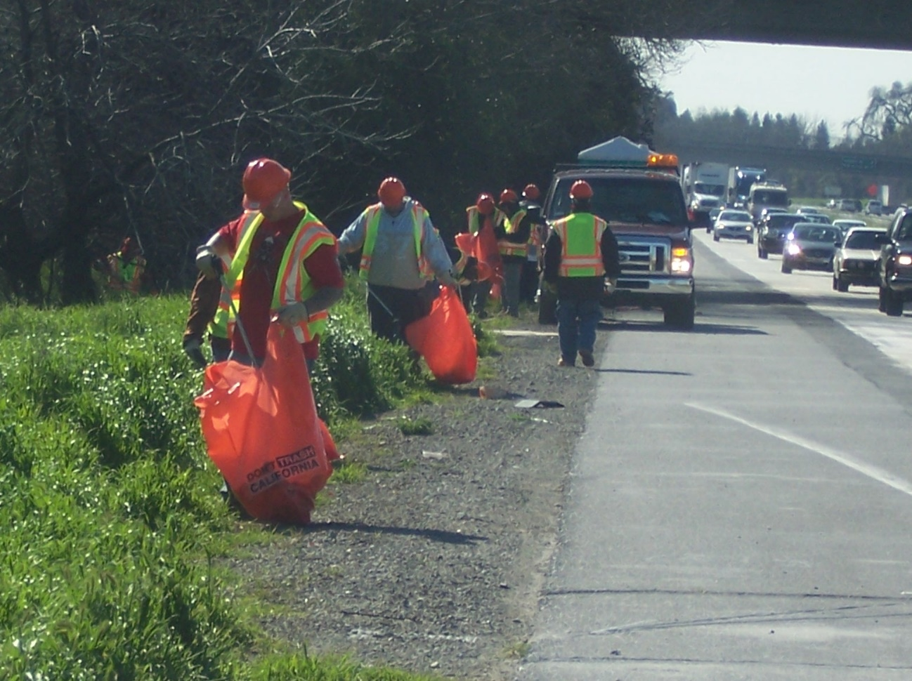
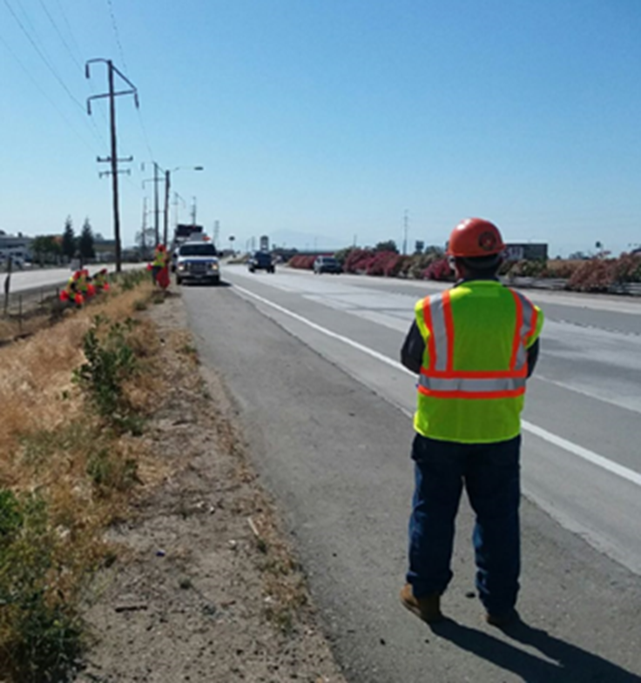
What's Wrong?
Correct Way

Slide 24
On/Off ramps-Quad areas-Gore points
Do not cross on/off ramps to retrieve litter/debris
To include side street exits (considered on/off ramp)
Do Not Work in Gore Points
Must have a protective or barrier vehicle to work on Off/On ramp shoulders
Advanced warning vehicle do not suffice.
PER Caltrans META SPP Training
Hazards at two Primary points:
Off Ramp Gore and Right Side of the on Ramp Gore Point
Working Near or within gore points beware:
Motorists are usually looking over their shoulder or in the rear view mirror
Stationary operations in gore areas, ramp closures and barrier vehicles should be placed to ensure safety in addition to required lane or shoulder closures on the through lane

Slide 25
=Areas of concern
Traveled way (mainline)
Right shoulder of entrance ramp
Gore point
Entrance ramp lane
Paved area
Landscaped/ hardscaped/ mulched/ dirt area
Quad Area
Entrance Ramp Gore Area
Notes:
DO NOT Work in Gore POINT, and DO NOT Work on ON/OFF Ramp Shoulder unless Protective vehicle is provided by Caltrans. While working in the Quad area maintain lookouts in multiple directions stay vigilant.

Slide 26
Quad Area
Landscaped/ hardscaped/ mulched/ dirt area
Traveled way (mainline)
EXIT
Right shoulder of exit ramp
Paved Area
Gore point
Exit ramp lane
=Areas of concern
Exit Ramp Gore Area
Notes:
DO NOT Work in Gore POINT, and DO NOT Work on ON/OFF Ramp Shoulder unless Protective vehicle is provided by Caltrans. While working in the Quad area maintain lookouts in multiple directions stay vigilant.

Slide 27
Signs and Cones
Signs and cones are tools to help you be safe
Place signs to warn the public about work on/near the traveled way
Placed in advance of lane/shoulder closure
Two or more orange flags
Cone placed next to each sign
A shadow vehicle should be used for setting and retrieving signs on the shoulder
Turn signs away from traffic when workers are not present
Notes:
Advance warning signs shall be placed when a stationary operation is on the traveled way, or is on the shoulder within 6 feet of a traffic lane on a multilane highway with a paved shoulder 8 feet or more in width.
Be careful while setting the Road Work Ahead signs. Work in front of the van.
Put 2 or more advanced warning sings where it can be seen for 1500 feet by approaching vehicles.
Don’t work more than a mile from your sign; if you do, either place another sign or move it up.
Don’t leave the signs up when you’re not out there working. It lessens their effectiveness.
Don’t set up signs that cause greater hazards such as impeding lanes
Per Contract: Local Caltrans Maintenance Supervisor or designee shall determine if worksite conditions require signs, flags or lane closures. If signage, flags or lane closures are appropriate for conditions, Caltrans will:
Either provide training to Sub-contractor so they may perform sign and flag setup
Setup signs and flags for Sub-contractor
Setup lane closure for Sub-contractor

Slide 28
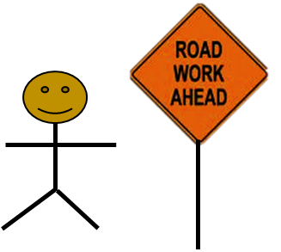
Lookout makes sure its clear and looks out for Sign set up crew
Sign Set up Crew Gets out of Van and grabs Sign, Flags, Sand Bag and Cones

Slide 29
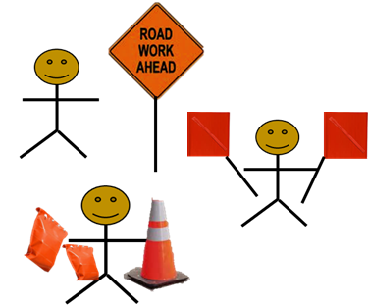
Sign crew sets up sign and flags in a safe location off of the shoulder away from the right away

Slide 30
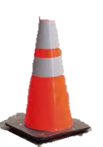
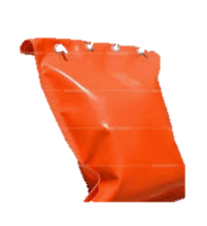
Place Sign with Flags on the paved shoulder not impeding Fog line. Place Sand bags on opposite sides of the stand.
Place cone in front of sign aligned with inside Corner of the sign.

Slide 31
Without the cone the driver may think the sign is impeding the fog line which can cause greater hazards

Slide 32
The Cone directly aligned with the inside corner of the Sign give drivers a line of site showing that the line does not impede on their lane.

Slide 33
Shoulder Closures
Shoulders are one of the most dangerous places to work
Keep a vehicle between yourself and traffic
Use a shoulder closure with protective vehicles for stationary operations
Avoid standing or working at the rear of your vehicle
SPP Crews do not close Shoulders, if shoulder must be closed it shall be done by Caltrans
Notes:
If you’re going to be at a single location along the shoulder for more than 30 minutes or so, consider closing the shoulder with traffic cones and a sign. Back 2 Work crews do not shut down shoulders
Per Contract: Local Caltrans Maintenance Supervisor or designee shall determine if worksite conditions require signs, flags or lane closures. If signage, flags or lane closures are appropriate for conditions, Caltrans will:
Either provide training to Sub-contractor so they may perform sign and flag setup
Setup signs and flags for Sub-contractor
Setup lane closure for Sub-contractor

Slide 34
Working On Opposite Sides
Crews shall not work directly across from other work operations on the same direction of travel
this includes moving operations
A distance of 2000 feet must be kept between operations working on opposite sides of the highway
Notes:
The intent of this guideline is to prevent the channeling of vehicles traveling in the same direction on a freeway or causing vehicles to cross the centerline of a two lane highway.
8.18 Maintenance Crews Working Across From Each Other
Maintenance crews shall not perform work directly across from each other on the same direction of travel on the State highway system (SHS). This includes moving operations.
The intent of this guideline is to prevent the channeling of vehicles traveling in the same direction on SHS or causing vehicles to cross the centerline of a two-lane highway.
Crews shall not perform work directly across from each other on opposite sides of the SHS unless there is a median barrier or other divider. A distance of at least 2,000 feet must be kept between operations if work must be accomplished at the same time.
However, if flaggers, stop signs, or traffic signals positively control the traffic, the work sites can be closer.

Slide 35
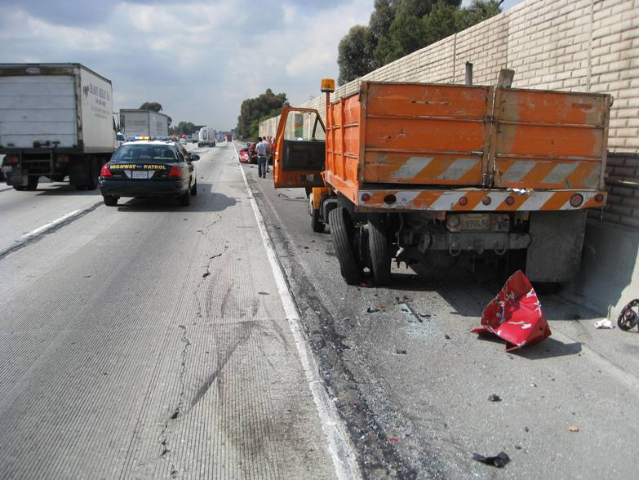
Notes:
barrier vehicle can save your life. Do not Work in areas such as above, because there is no escape routes

Slide 36
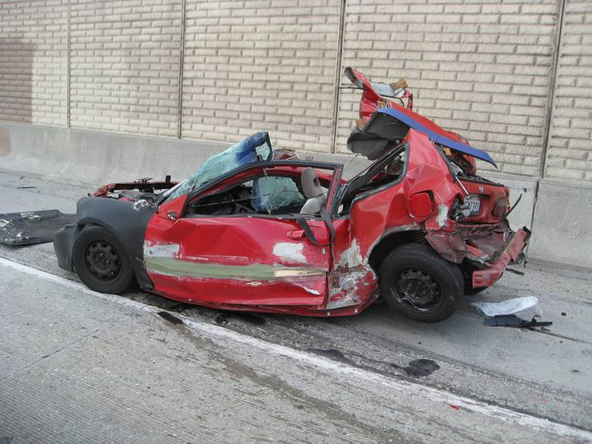
Notes:
Vehicle that hit our barrier vehicle. Luckily, the motorist was able to walk away.

Slide 37
Procedures for picking up litter
Dropping off 1 at a time (if allowed) so they can walk toward the pickup point facing traffic, much like Adopt A Highway does
Dropping off 2-3 at a time so they can walk toward the pickup point facing traffic, with one of them working as a lookout (Leapfrog)
If it is decided that the crew will all work together in a group, they should use a shadow vehicle behind the van moving along the shoulder, shielding the group of workers. Shadow vehicle will be provided by Caltrans.
Notes:
Consider dropping the workers off and work facing traffic, if possible. If not, make sure someone is watching traffic.
You as the van driver could roll along with the crew, constantly watching your mirrors to warn of errant vehicles.
Discuss what you’ll be using as a warning signal; the van’s horn, lookouts horn, yelling, etc. beforehand.
Discuss process of leapfrog vs working in group as a whole

Slide 38
Leap Frog method:
Set up Sign 1
Set up Sign 2 and drop off group 1 of workers
Workers move to sign 1 with Spotter behind
Set up Sign 3 and drop off group 2 of workers
Workers move to sign 2 with spotter
Driver Round Robins and picks up group 1 at sign 1 dismantles sign
Pick up Group 2 at sign 2 dismantles sign
Pick up Sign 3

Slide 39
Picking up Litter and Debris
The safest way to pick up litter is to work individually and face traffic
SPP Crews use Yellow bags issued by Caltrans
Don’t overfill litter bags
Tie the top of the bag, if possible
Place them in a safe location for pickup; off of the pavement/paved shoulder
No sharp objects (glass/needles/metal)
Place heavy objects (tires, boards, etc.) near the filled bags
Notes:
Reinforce the idea of tying the bags (keeps litter from scattering in the wind or when loading), not filling bags too full (if it gets heavy tie it up and get another bag, and placing it where it can safely and easily be picked up by Caltrans personnel. )
We have LOTS of bags!
Stack the bags in piles if you can; it really helps.
SPP crews use Yellow bags

Slide 40
Bag it? Move it? Leave it?
Bag it…
These items may be placed in a bag:
Papers, cardboard, plastic, Styrofoam, wood, rubber, glass or metal items with no sharp edges
Small, empty containers (cans/bottles/etc.) provided they don’t have sharp edges
Notes:
Self-explanatory

Slide 41
Bag it? Move it? Leave it?
Move it…
These items should be placed alongside bags on the shoulder:
Large or heavy items with pointed/sharp edges that could tear a bag
Tire carcasses, large boards, items that cannot fit in a bag
Containers that contain liquid and won’t spill (if the contents aren’t hazardous)
Notes:
Self-explanatory

Slide 42
Bag it? Move it? Leave it?
Leave it!
Leave these items where found without taking further action:
Heavy or sharp items that could cause injury if moved or handled
Items in an unsafe or unstable location
Hazardous materials
Possible crime scene evidence
Any item you cannot identify
Notes:
Self-explanatory

Slide 43
Working on uneven/steep ground
Watch for squirrel holes, washouts, mounds, etc. hidden in tall grass
Ground may be soft in ditch lines even if water is not present
Use care when climbing/descending slopes; walk carefully at an angle to the slope if possible
Fall Protection needed on Sloped Surfaces steeper than 40 degrees with a potential fall of 7 ½ feet
Notes:
You never know when a hole will be hidden in tall grass. Be careful.
Wet weeds/grass can be slippery on slopes. Be careful.
8.30 Fall Protection
Approved personal fall arrest, personal fall restraint or positioning systems shall be worn by those employees whose work exposes them to falling in excess of 7 1/2 feet from the perimeter of a structure, unprotected sides and edges, leading edges, through shaft ways and openings, sloped roof surfaces steeper than 7:12, or other sloped surfaces steeper than 40 degrees.

Slide 44
Hidden hazards
What hazards can we come across?
Snakes and other vermin sometimes hide under boards/objects lying in the weeds
Be careful when lifting items (boards, plywood, large pieces of plastic, etc.) that have been obviously lying there for awhile
Move the object with your litter-picker and stand back until you’re sure nothing is underneath
Watch for wasp nests and concentrations of bees; stay clear!
Notes:
We had a Caltrans worker bitten by a rattlesnake that was found under a full litter bag right on the edge of the highway.
Certain wasps and bees live in holes in the ground. If you notice a large concentration of bees or wasps, vacate the area.

Slide 45
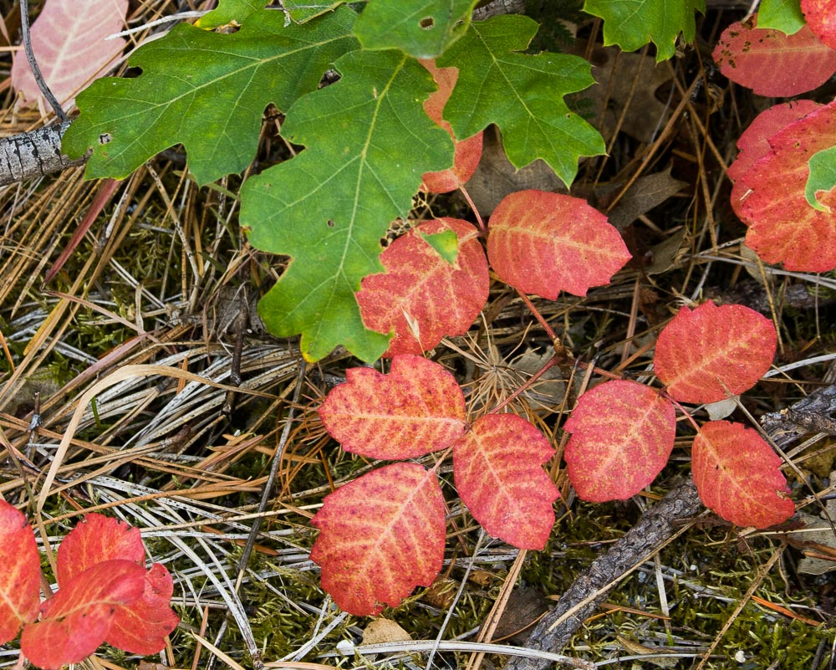
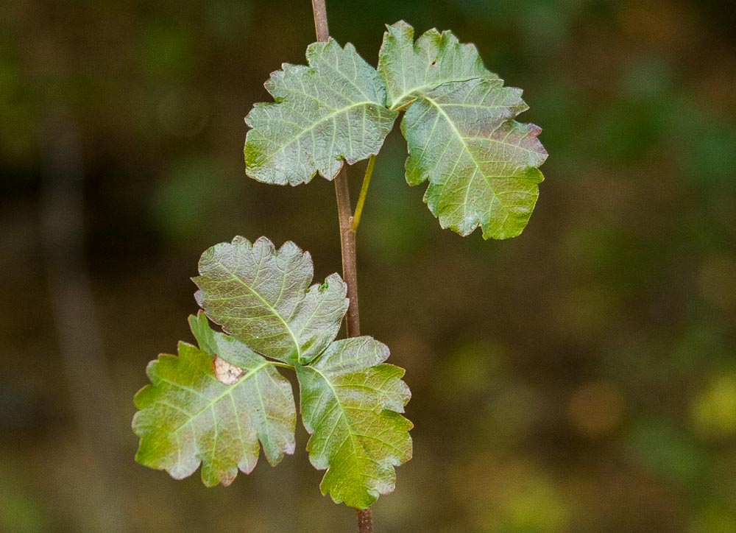
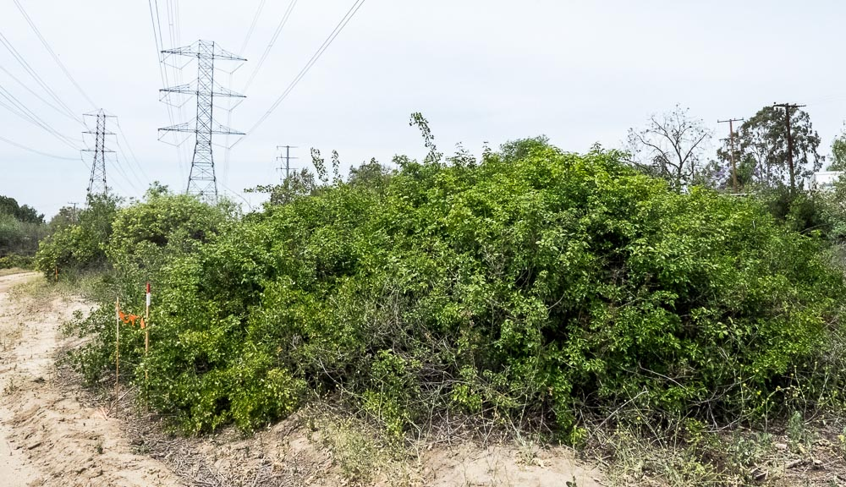
Hazardous Poisonous Plants
How Poison Ivy Works Video
Notes:
Leaves of 3 let it be, don’t ingest oleander or inhale smoke if burning. Oleander, which grows in backyards, public parks and along streets throughout California, can cause death in rare cases when a substance called oleandrin is absorbed into the bloodstream, causing abnormal heartbeats and eventually proving toxic to the heart
Left: These are typical red poison oak leaves in September. Note that the green leaves at the top are actual oak leaves and don't look much like poison oak.
Middle: Poison oak leaves with a sharply notched look growing up a thick vertical stalk. This is the shrub form of the plant. Stocks grow left then right never across from each other
Right: A massive hedge of poison oak growing below the power lines. Fall into this and get ready for the ER a few days later.
Bottom Mid- Oleander

Slide 46
Hazardous Substances
Do not pick up anything that looks like it could be hazardous
You may find discarded drug lab chemicals, pesticides, urine, syringes, pipe bombs/explosives and other hazardous substances along the highway
Some hazardous items may have labels or placards
Warn other workers of the possible danger and notify your Supervisor immediately!
Notes:
Protect yourself, protect traffic, protect the environment.
Do not endanger your life.

Slide 47
Labels/Placards
Watch out for these:
Leave them alone! Call the Experts!
Notes:
You may find items (boxes, plastic containers, plastic or metal drums) with these or similar labels. They are there to alert you of danger. Leave them alone, let the Crew Supervisor know. Then call the Caltrans Supervisor; he will take care of it.

Slide 48
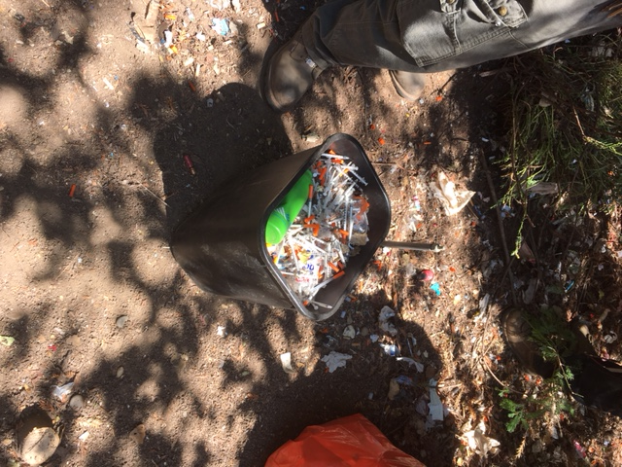
Handling & Disposing of Hypodermic Needles
Under No Circumstances should you pick up discarded needles with your hands. Use a litter-picker or other device
Place in Sharps container, DO NOT HOLD container!
Never put needle in a Bag only approved Sharps Containers
Do not store needles in the cab or where they may accidentally come in contact with another person, your clothes or foodstuffs
Store Containers in secure area where contact will be avoided
If you feel you came into contact with any infectious item
Notify your Supervisors
Wash contaminated area immediately with soap and water
Notes:
2. Under no circumstances should you pick up discarded hypodermic needles with your
hands. Use a litter-picker or other device. Needles can puncture leather gloves.
3. Place hypodermic needles in a leak-proof, rigid, puncture-resistant container ("Sharps
Container" provided by your Supervisor). Do not hand hold container while placing
needles inside with a litter picker; YOU MAY ACCIDENTLY PUNCTURE YOUR HAND.
Place the open container on the ground before attempting to put the needle inside the
Sharps container. Containers must be labeled as a biohazard.
4. Do not carry or store needles in the cab of your vehicle or anywhere where they may
accidentally come in contact with another person, your clothes or foodstuffs.
5. Store containers with used needles in secure areas where contact will be avoided. For
disposal, use the services of Hazardous Spill Cleanup Contractors. Contact a properly
trained First Responder.
6. If you feel you may have come in contact with any item that may be infectious, notify
your Supervisor. Wash the contaminated area immediately with soap and water.
Towelette preps in the first aid kit may also be used to disinfect the hands. Wash
thoroughly with clean water and soap before eating, drinking, smoking or using the
restroom.

Slide 49
Homeless Encampments
Shall not allow crews to cleanup active homeless encampments
Shall remove litter and debris once encampment is deemed safe by the following:
The processes and procedures set forth in CALTRANS’ “Interim Guidance on Encampments”
Shall not engage in any hazardous material clean-up activities
Including but not limited to bloodborne pathogens, biological waste, feces, syringes, needles, sharp objects or unknown substances during maintenance services
Caltrans should use hazmat contractors for major cleanup activities
Once Deemed safe encampments will be categorized as litter/Debris
If a Back 2 Work Supervisor in “Good Faith” believes the site is unsafe due to hazardous material/Biohazards or the lack of set forth process it is their responsibility to regroup in a safe area, communicate with CT lead to re-plan the work order and/or request a different work order.
Notes:
If time permits see Caltrans interim Guidance on Encampments Presentation: https://catc.ca.gov/-/media/ctc-media/documents/ctc-meetings/2021/2021-01/workshop/wrkshp-tab-3-caltrans-a11y.pdf
Refer to contract attachment IX Caltrans interim Guidance on Encampments

Slide 50
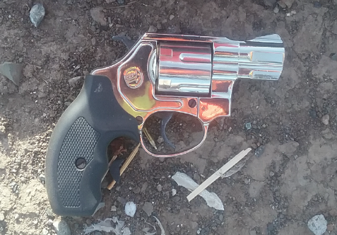
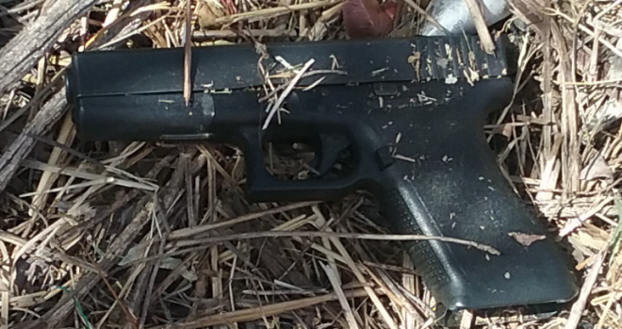
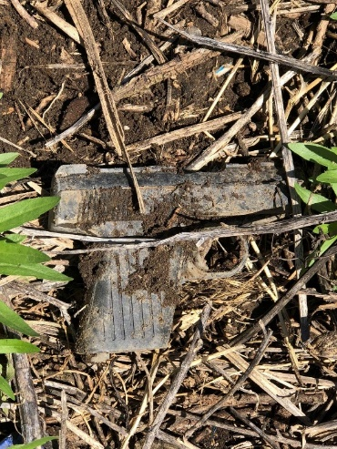
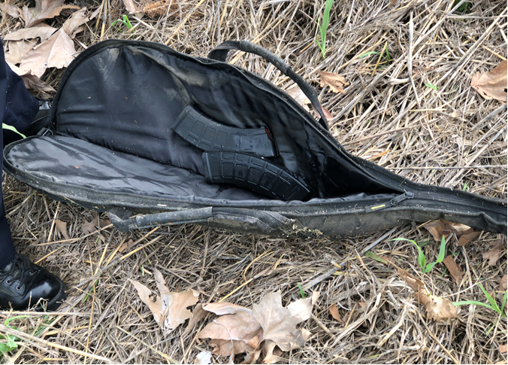
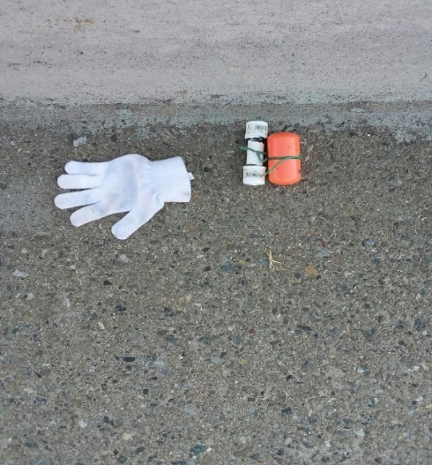
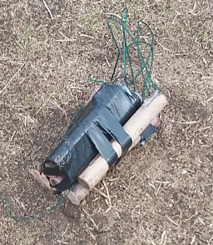
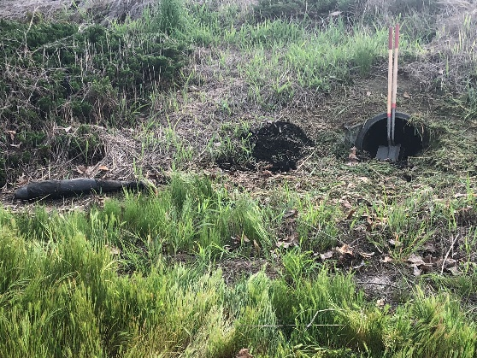
Weapons
Weapons have been found on the State Right of Way.
Leave it alone! It may be crime scene evidence
Tell your Crew Leader
Do NOT put your fingerprints on ANY weapon!
Notes:
Cannot stress this enough.

Slide 51
Emergencies?
Call 9-1-1 for dire emergencies
Call the local Caltrans Transportation Management Center (TMC) for “urgent” assistance
Call the local Caltrans Maintenance Supervisor for assistance with other issues
Notes:
Every Crew Leader will have a list of numbers to call.

Slide 52
Roadside Safety Training Summary
Discussed Scope of Work and Responsibilities
Identified Proper Clothing and Personal Protective Equipment
Recognized potential Hazards and suitable abatement measures
Explained Proper use and Placement of signs/cones
Discussed the correct methods of retrieving litter/debris
Demonstrated techniques to Handle Hypodermic Needles
Increased everyone's Knowledge to maintain Safety First approach
Notes:
Read each one.

Slide 53
Heat Illness Prevention
Training for Supervisors and Employees

Slide 54
Training Program Objectives
Identify, evaluate and control potential risk factors
Provide information and training to supervisors and employees
Discuss proper response to heat-related illnesses

Slide 55
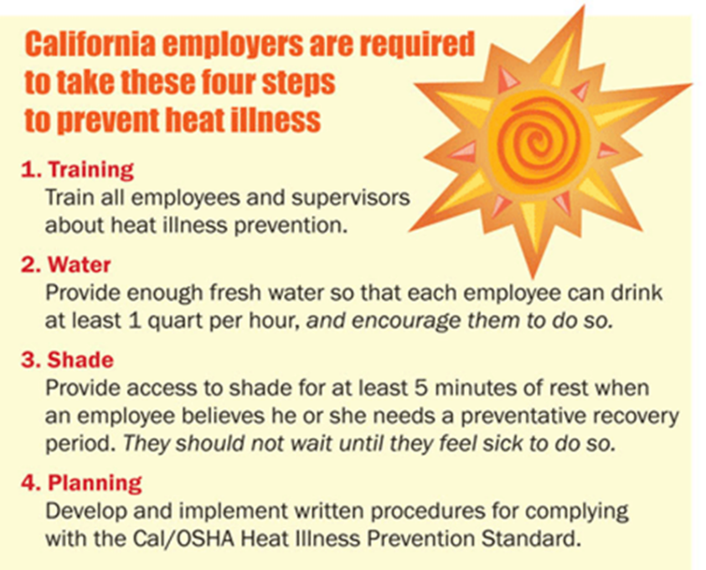
What is Heat Illness?
“HEAT ILLNESS” – A serious medical condition resulting from the body’s inability to cope with a particular heat load, and includes cramps, heat exhaustion, heat syncope, and heat stroke.
Notes:
“Heat Illness” also referred to “Heat Stress”
We need to maintain our internal body temperature within a very narrow range of a few degrees above or below 98.2 degrees Fahrenheit. People suffer from heat illness when their bodies are not able to get rid of excess heat and properly cool. The body loses it’s “heat balance” because it can not shed heat at a fast enough rate.
During an 8-hour of heavy work in hot weather, the body can easily sweat out one quart of water.
Blood vessels get bigger and heart beats fast and harder. More blood flows to the outer layers of the skin from the internal “core” so that the heat can be released into the cooler outside environment. If this process does not cool the body fast enough, or the outside air is warmer than the skin, the brain triggers sweating to cool the body. Sweat glands in the skin draw water from the bloodstream making sweat. The sweat evaporates and releases the heat from the body.

Slide 56
Supervisor Responsibilities
Implementing a written outdoor heat stress program (In IIPP)
Evaluating and controlling outdoor heat stress factors
Training employees
Provide Access to Shade
Encouraging frequent water consumption (one quart of water per employee per hour)
Provide proper response to heat-related illness

Slide 57
Employee Responsibilities
Monitoring personal factors for heat-related illness
Frequently drinking water
Reporting signs and symptoms of heat-related illness to their supervisor

Slide 58
Personal factors
Age, Weight, Degree of Physical Fitness, Degree of Acclimatization, Medical Condition
Use of caffeine, Smoking, Use of alcohol
It is difficult to predict just who will be affected and when, because individual susceptibility varies
Notes:
PERSONAL RISK FACTORS
Do not discuss person’s age.
DO TELL EMPLOYEES:
“If you are taking medication check to see if it is a heat or sun sensitive drug”
“Go home and check. Do not bring them to me, I am not a doctor nor pharmacist”

Slide 59
Helpful tips for working in the heat
Start and end the work shift early
Schedule strenuous work during the coolest part of the day
Increase breaks when: Very hot, Workload is heavy, Protective clothing limits cooling
Take breaks in a shaded, cooler area
Alternate heavy work with light work when possible
Have a “Buddy System” to keep an eye on co-workers for symptoms of heat illness
Notes:
59

Slide 60
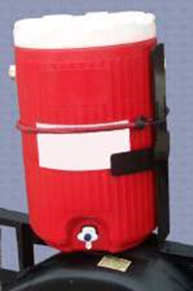
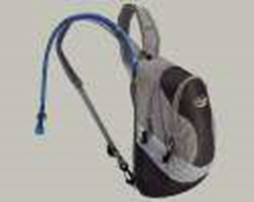
WATER CONSUMPTION
Drink small quantities of water throughout the day.
One quart or more Per hour- when the work environment is hot and sweating more than usual.
Supervisors are responsible for encouraging water consumption.
Employees are responsible for their consumption of water.
Notes:
60
Note: Suitably cool water should be sixty degrees Fahrenheit or less. During hot weather, employees may require up to three gallons of water per day. With this water consumption comes a need to use the bathroom. Facilities need to be available and workers must be given the opportunity to use them as needed.
Water- All employees shall have access to potable drinking. Where water is not plumbed or otherwise continuously supplies, it shall be provided in sufficient quantity at the beginning of the work shift to provide one quart per employee per hour for drinking for the entire shift.

Slide 61
Proper hydration
DO:
Start work well hydrated
Drink plenty of water throughout the day
Consider sports drinks for electrolyte replacement
AVOID:
Drinking Soda and other sugary drinks
Drinking lots of coffee and tea
Drinking alcohol
Waiting for thirst before drinking water
Notes:
61
By “hydration” we mean drinking enough water. If you become dehydrated, heat illness can occur.
The most effective way for preventing heat stress is to steadily replenish the water that the body loses as sweat.
Drinking a large amount of water all at once after sweating heavily for a long time is not as effective and can even be dangerous.
About 1 quart every hour
Cool liquids are better than ice cold
Supply adequate water and encourage employees to drink regularly.
Workers in restricted environments (sewers, etc.) should drink before entry and at regular intervals.

Slide 62
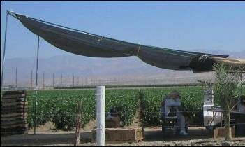
When the Temperature Exceeds 80°F
Provide enough shade to accommodate the number of employees on breaks and meal periods
Shade can be improvised: Van with AC on
Remember: Access to shade must be permitted at all times. Shaded area must not cause exposure to another health or safety hazard

Slide 63
Take Breaks in the shade
Monitor employees on cool down rests
Ask if they’re experiencing symptoms of heat illness
Don’t order back to work until symptoms abated
Allow at least a 5 minute rest
Take appropriate first aid steps or emergency response

Slide 64
Temperature Equals or Exceeds 95°F
Ensure effective communication
Observe employees for alertness and signs and symptoms
Supervisory or designee observation of 20 or fewer employees
Mandatory buddy system
Regular communication
Give more frequent reminders to drink plenty of water.
Hold pre-shift tailgates on prevention

Slide 65
Acclimatization
Temporary adaptation of the body to work in the heat that occurs gradually when a person is exposed to it.
Acclimatization peaks in most people within 4 to 14 days of regular work for at least 2 hours per day in the heat.
Pay special attention to:
New employees
People just back from being sick
Anyone absent for more than a week
People who have just moved from a cooler climate
Everyone during heat wave events
Notes:
65
ACCLIMATIZATION– Self explanatory – Are employees used to working in the heat before going out there? Start slowly. Important for new employees (SPPs)
ENVIRONMENTAL RISK FACTORS
-WELCOME TO SUNNY CALIFORNIA
-SOME PLACES HAVE MORE OR LESS HUMIDITY DEPENDING OF THE TIME OF THE YEAR
ENVIRONMENTAL RISK FACTORS FOR HEAT ILLNESS INCLUDE:
WORKLOAD SEVERITY AND DURATION
-LIGHT WORK – DRIVING, WALKING AROUND
-MODERATE – UNLOADING
-STRENUOUS – CONSTANT WORKING, NONE STOP
PPE – Some PPE that might reduce natural airflow can increase your risk of a heat related injury.
You need to know and understand your PPE and make necessary adjustments to your work.

Slide 66
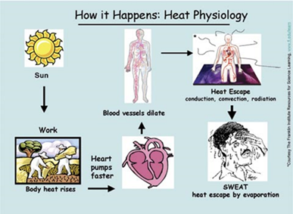
How the body controls heat
When body core temperature rises:
Blood flows to skin, Sweating increases
Heart rate increases to move blood and heat to the skin
When this works well: Core temperature drops or stabilizes at a safe level
Notes:
A body at work generates heat faster when working than at rest, often more than needed. Roughly three-fourths of the stored energy the body draws on during activity converts to heat rather than motion, and more strenuous activity naturally generates more heat. Elevation of core body temperature disturbs functioning, so the body protects itself by dissipating excess heat. The mechanisms of vasodilatation and sweating are critical to moving heat from a human body to the environment. When the body's core temperature exceeds its norm (generally 98.6 degrees), veins and capillaries expand, the heart beats faster, and blood flow increases to outer layers of skin, from which heat is radiated to the cooler exterior environment. If, however, the body cannot cool fast enough through this means, or when surrounding air is warmer than the skin, the brain signals sweat glands to release sweat to the skin surface. Evaporation of the sweat carries additional heat from the body. Because high humidity decreases the sweat evaporation rate, it slows cooling. After becoming "acclimatized" to a hot environment over time, people sweat more readily and thus cool more efficiently.
These cooling mechanisms, however, can impair strength and comfort. Increasing blood flow to the body surface reduces the volume carrying oxygen to muscles, brain, and other internal organs, which in turn accelerates fatigue and diminishes mental alertness. The loss of water volume through sweating also contributes to fatigue by increasing blood viscosity, making it more difficult for the heart to pump and reducing the body's capacity for subsequent cooling. Finally, because prolonged sweating depletes not only heat but also electrolytes that are needed for muscle functioning, it can cause cramping.
To maintain comfort and health when working in a hot environment, it is critical for people to replace both the water and electrolytes they lose through sweating. If body fluid is not replenished at the same rate as it is lost, or if replacement lacks electrolytes, the cooling mechanisms lose effectiveness and exposure to heat stress rises. One of the body's most important methods of temperature regulation is perspiration. Evaporation of the sweat produces cooling, since this endothermic process draws heat from the body. When the body becomes sufficiently dehydrated to prevent the production of sweat this avenue of heat reduction is closed. When the body is no longer capable of sweating, core temperature begins to rise swiftly.
Victims may become confused, may become hostile, often experience headache, and may seem intoxicated. Blood pressure may drop significantly from dehydration, leading to possible fainting or dizziness, especially if the victim stands suddenly. Heart rate and respiration rate will increase as blood pressure drops and the heart attempts to supply enough oxygen to the body. The skin will become red as blood vessels dilate in an attempt to increase heat dissipation, sometimes leading to swollen lips. The decrease in blood pressure will cause blood vessels to contract as heat stroke progresses, resulting in a pale or bluish skin color. Complaints of feeling hot may be followed by chills and trembling, as is the case in fever. Some victims, especially young children, may suffer convulsions. Acute dehydration such as that accompanying heat stroke can produce nausea and vomiting; temporary blindness may also be observed. Eventually, as body organs begin to fail, unconsciousness and coma will result.

Slide 67
Causes of Heat Related Illness
So much sweat is lost that
Dehydration results
The body cannot cool itself by sweating and the core temperature rises
Salt loss causes heat cramps
So much blood flow goes to the skin that other organs can not function properly
The body is subject to more heat than it can cope with and heat exhaustion and heat stroke can occur

Slide 68
How to Respond to Signs and Symptoms
Cease work and report condition to supervisor
Be relieved from duty and provided means to reduce body temperature
Employees experiencing sunburn, heat rash or heat cramps will be monitored to determine whether medical attention is necessary
911 must be called if employees experience signs and symptoms of heat exhaustion or stroke
Fill out an Incident Report for any heat related incident

Slide 69
HEAT ILLNESS TYPES
HEAT RASH – A skin irritation caused by excessive sweating and clogged pores during hot, humid weather.
HEAT SYNCOPE – Fainting
HEAT EXHAUSTION – The body’s response to an excessive loss of the water and the salt contained in sweat.
HEAT STROKE – Usually fatal unless emergency medical treatment is provided promptly.

Slide 70
Heat Rash
Causes: Hot, humid environments where sweat is not easily removed from the skin by evaporation and the skin remains wet.
Symptoms: The sweat ducts become plugged, a skin rash soon appears, infection-prickly heat can occur
Treatment: The worker can prevent this condition by resting in a cool place part of each day, regularly bathing and drying the skin.
Notes:
70
HEAT RASH GENERAL SYMPTOMS:
1)CAN COVER LARGE PARTS OF THE BODY 2) LOOKS LIKE A RED CLUSTER OF PIMPLES OR SMALL BLISTERS 3)OFTEN OCCURS ON THE NECK, CHEST, GROIN, OR IN ELBOW CREASES 4)UNCOMFORTABLE SO IT CAN DISRUPT SLEEP AND WORK PERFORMANCE 5)COMPLICATED BY INFECTIONS
Heat Rash also called prickly heat is a common condition in which areas of skin itch intensely and often feel prickly or sting due to overheating. Heat rash looks like tiny bumps surrounded by a zone of red skin. It usually occurs on clothed parts of the body, such as the back . Abdomen, neck, upper chest it goes away on its own in a few days. Heat rash begins with excessive perspiration, usually in a hot, humid environment. The perspiration damages cells on the surface of the skin, forming a barrier and trapping sweat beneath the skin, where it builds up, causing the characteristic bumps. As the bumps burst and sweat is released , you may feel the prickly or stinging sensation that gives the condition its common name

Slide 71
Heat Syncope
Causes: Blood pressure is lowered as the capillaries dilates. Water is evaporated from the blood, reducing the blood's volume lowering blood pressure further, less blood to the brain.
Symptoms: Dizziness, lightheadedness, weakness, tunnel vision, loss of consciousness, decreased/week pulse, Pale skin
Treatment: Increase fluid intake, rest and move to a cool place. Get medical attention if symptoms persist
Notes:
HEAT SYNCOPE – FAINTING
heat-loss mechanisms, such as sweating, panting,, act to reduce body temperature. The body gets these signals when warm thermo receptors prevail over signals from cold thermo receptors. Due to Vasodilatation which is the widening of blood vessels in the skin and excessive sweating, there is circulatory and vasomotor instability
SUDDEN DIZZINESS 2) LIGHT HEADEDNESS 3)UNCONSCIOUSNESS
Heat syncope is another stage in the same process as heat stroke, occurs under similar conditions as heat stroke. The basic symptom of heat syncope is a body temperature above 104°F with fainting, or without mental confusion, which does occur in heat stroke. Heat syncope is caused by mild overheating with inadequate water or salt. In young persons, it is far more common than true sunstroke.
[edit] Causes
Heat syncope occurs when blood pressure is lowered as the body dilates (widens) capillaries (small blood vessels) in the skin to radiate heat. Also, water is evaporated from the blood, reducing the blood's volume and therefore lowering blood pressure further. The result is less blood to the brain, causing light-headedness and fainting.
[edit] Treatment
The basic treatment for heat syncope is like fainting: the patient is positioned in a seating or supine position with legs raised. Water and oral rehydration salt are administered slowly, and the patient is moved to a cooler area.

Slide 72
Heat Exhaustion
Causes: Loss of body fluids and salts due to overexposure to high temperatures and humidity. Usually one is exposed to heat for a prolonged amount of time and becomes dehydrated.
Symptoms: Headache, nausea, fatigue, dizziness, skin is cool and pale, pupils become dilated. Usually conscious but may faint, has a core temperature of over 102.
Treatment: Call 911, Get to the shade, cool off, increase fluids, cold wet towels or ice, fan, elevate legs above heart, loosen clothing.
Notes:
Heat Exhaustion starts with the accumulation of large quantities of blood in the skin in the body’s attempt to increase it’s cooling efficiency.
This is normally due to temperature conditions the individual is not used to.
There is a loss of circulating blood volume in the body which decreases the blood supply to the brain, increasing the likelihood of fainting. Older employees or those with high blood pressure are more susceptible to heat exhaustion
C. HEAT EXHAUSTION
It is due to salt and water depletion occurring due to excessive sweating. This occurs when a person is exposed to high temperature for a long period or the body may become dehydrated and temperature regulation system bay begin to fail.
Symptoms include 1) Heavy sweating 2)Painful muscle cramps 3)Extreme weakness and/or fatigue 4)Nausea and/or vomiting 5)Dizziness and/or headache 6)Body temperature normal or slightly high 7)Fainting 8)Pulse fast and weak 9) Breathing fast and shallow 10) Clammy, pale, cool, and/or moist skin

Slide 73
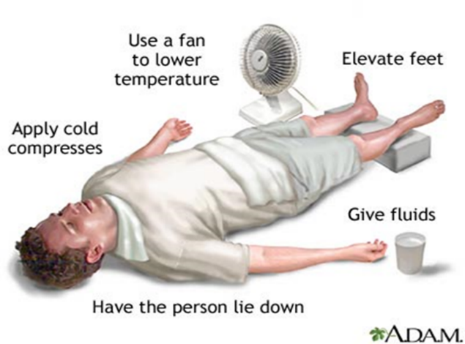
Heat Stroke
Causes: Failure of the heat-regulating mechanisms of the body, due to high heat and humidity.
Symptoms: Headache, nausea, dizziness, skin is red-dry-hot, sweating has ceased. Pulse is rapid, small pupils, fever of 105. May be disorientated, lose consciousness, possible convulsions.
Treatment: Call 911, move to shady area, loosen clothing, apply cool or tepid water to the skin, fan off to promote sweating and evaporation, place ice packs under armpits and groins.
Notes:
The underlying cause of heat stroke is connected to the sudden inability to dissipate body heat through perspiration.
This accounts for the excessive rise in body temperature and it’s the high fever which can cause permanent damage to internal organs, and can lead to death.
When someone passes out from heat stroke, his or her brain is being cooked just as the colorless part of an egg turns white when it hits the griddle.
Any cold liquid should be used to cool the victim.
Once revived, the victim should be watched for more than an hour as his temperature can start to rise to high levels again.
HEAT STROKE Under most extreme conditions, the body temperature regulation may begin to fail. Peron may become mentally confused and aggressive, very little perspiration
Even No sweating because the body cannot release heat or cool down 2) Mental confusion, delirium, convulsions, dizziness 3)Hot and dry skin 4)
Muscles may twitch uncontrollably 5) Pulse can be rapid and weak 6) Headaches 7) Unconsciousness 8) Body Temp from 102-104 F within 10-15 minutes
When the body temperature reaches 105 It is considered heat pyrexia.
Hyperthermia, in its advanced state referred to as heat stroke or sunstroke, is an acute condition which occurs when the body produces or absorbs more heat than it can dissipate. It is usually caused by prolonged exposure to high temperatures. The heat-regulating mechanisms of the body eventually become overwhelmed and unable to effectively deal with the heat, causing the body temperature to climb uncontrollably. Hyperthermia is a medical emergency which requires immediate treatment.

Slide 74
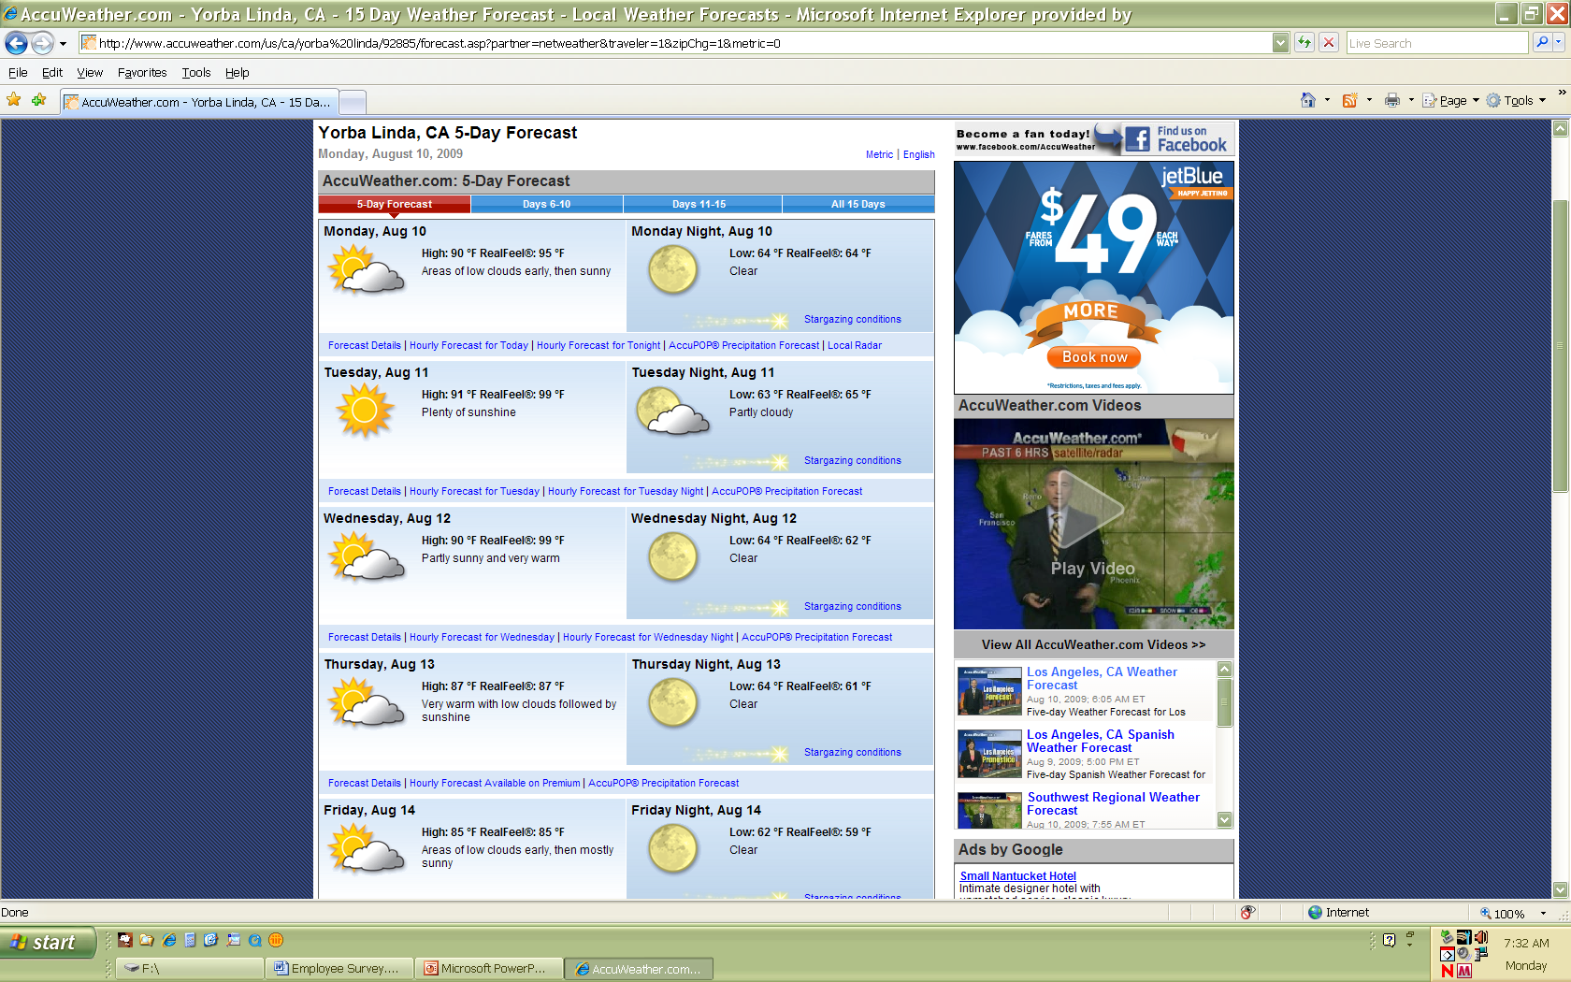
Monitor Temperatures

Slide 75
Heat Illness Supervisor Checklist:
Training
Temperature Monitoring
Un-acclimatized Employees
Workload/Work Intensity
Provide Adequate Water
Rest Periods
Access to Shade
Emergency Procedures
Notes:
TRAINING – TAILGATE MEETING – Discuss What it is? What Causes It? How to prepare and respond.
TEMPERATURE MONITORING
Check weather ahead of time. Use the web for particular job site area. (City). Don’t have an attitude of it’s just hot, be informed of temperature.
UNACCLIMATIZED EMPLOYEES– Employees not used to working in heat before, start off slowly. (SPPs)
Assign jobs with less work intensity, buddy system, utilizing an experienced worker who sets a good example as it relates to heat illness prevention; Extra vigilance from supervision at the site
Untrained Employees – Review the Heat Illness Prevention
UNTRAINED EMPLOYEES - Heat stress disorders and symptoms
Workload/Work Intensity – Plan ahead, can activities be broken down, litter pick up, cover smaller area than customary…?
Light workload driving vehicle around
Moderate – Unloading
Strenuous – Constant working – none stop
CLOTHING REQUIREMENTS
PPE It’s best to wear comfortable, yet sturdy outer garments.
Wear a broad brimmed hard hat and neck shade
PROVIDE ADEQUATE WATER AND SHADE
1. Remind employees to drink water in the evening and before coming to work
2. Changing work schedules
3. Additional water and rest breaks
4. Additional cooling measures
MAKE AVAILABLE AT LEAST 2 QUARTS PER EMPLOYEE AT THE START OF THE SHIFT.
MONITOR WATER CONTAINTER EVERY 30 MINUTES
REMINDERS TO DRINK WATER FREQUENTLY AND MORE WATER BREAKS PROVIDED
SHADE: Employees will have access to cooled office or other indoor space with air conditioning, if available. TREES, ARE ACCEPTABLE, BIG TREES, LOTS OF LEAVES ENOUGH SHADE. SHADE IS WHERE YOU DON’T CAST A SHADOW. CANOPIES, UMBRELLAS WILL BE SET UP AT THE START OF THE SHIFT AND WILL RELOCATE THEM AS WORKERS MOVE. PLACE SHADE AS CLOSE AS FEASIBLE TO THE WORK ACTIVITY. EMPLOYEES SHOULD BE ALLOWED 5 MINUTES IN SHADED AREA.
EMERGENCY PROCEDURES
Know where you are located and how to get there if you must give directions to emergency responders. In the event of a heat related illness do the following if necessary: Call 911 if heat stroke is detected or other than a “Preventative Recovery Period” is needed…DO IT NOW”! While waiting for emergency services to arrive start heat illness first aid by: Moving the employee to a shaded area; soak victim’s clothing with cool water; fan victim
Sometimes a victim’s muscles will begin to twitch uncontrollably as a result of heat stroke. If this happens, keep the victim from injuring themselves but do not place any object in the mouth and do not give fluids.

Slide 76
Remember
Drink water frequently !!
Know the signs and symptoms of heat related illnesses
Consider sports drinks when sweating a lot
Avoid alcohol, caffeinated drinks, and heavy meals
Acclimate
Wear appropriate clothing
Take regular breaks in a shaded cool area
Keep an eye on your buddy!
Notes:
76

Slide 77
Questions???

